Slide 1
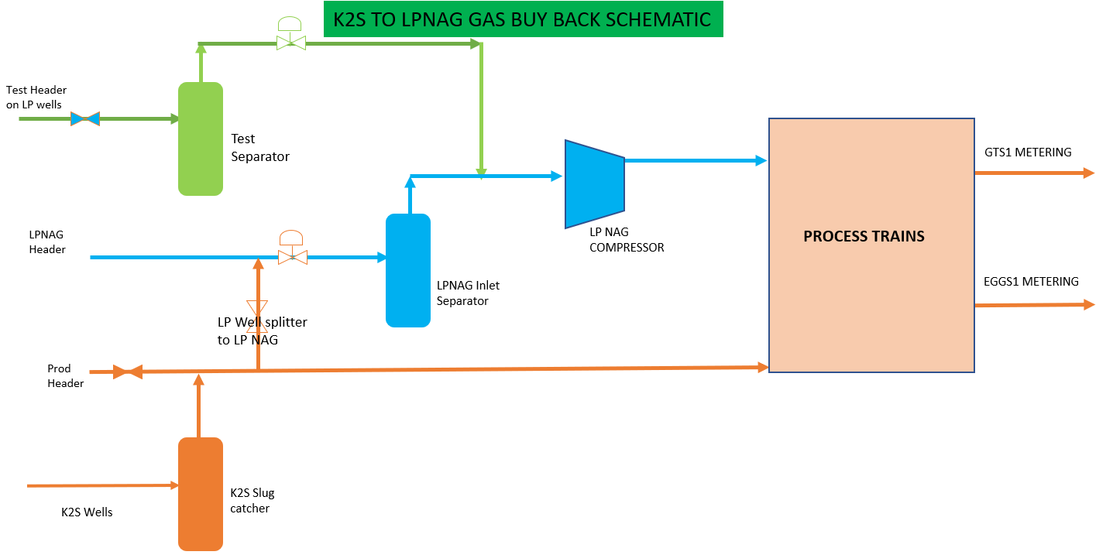
LP NAG Compressor Gas Buy Back from K2S: Innovation at its best, opportunity to replicate at sister asset
Background
On the 18th of July 2023, the SOKU2SAN-BARTH project, a condensate sales agreement with NewcrossEP was commissioned thereby bringing an “END” to the use of NCTL to evacuate over 20KBWD from the SOKU LPNAG wells. For SOKU to remain in operation there must be an alternate route to safely dispose its produced water. We currently have a produced water disposal system that allows only about 4.5Kbblsd injection. Under the circumstances, SOKU GP will need to cream to cut back the excess water to remain in operation After a careful tank water inflow simulation, the equivalent volume of gas to required to produce 4.5Kbblsd water was about 70Mmscfd. This volume of gas is far below the minimum turn down of the LP NAG compressor which was advised to be between 120Mmscfd and 150Mmscfd. The safe option was to shutdown the LPNAG compressor and use the SOKU GP to process only gas from K2S well.
WELL ID | Wet Gas (MMScfd) | Dry Gas (MMScfd) | Condensate (bpd) | Water (bpd)
K2S W43 | 140 | 130 | 9000 | 100
K2S W44 | 140 | 130 | 9000 | 100
K2S W47T | 143 | 140 | 5900 | 88
K2S W48T | 40 | 35 | 2800 | 13
K2S W49T | 120 | 100 | 6000 | 55
K2S W45T | 130 | 110 | 9000 | 100
K2S Total | 713 | 645 | 41,700 | 456
SOK W47T | 20 | 15 | 36 | 564
SOK W49T | 80 | 30 | 290 | 2036
SOK W51T | 78 | 25 | 667 | 1899
 | 178 | 70 | 993 | 4499
Solution- What the team did
With the availability of the production facilities and with the flexibility of interconnecting valves, the team was able to see an opportunity to produce the SOKU NAG wells below the compressor minimum turn down by routing gas from K2S slug catcher to fill the NAG compressor through the LP NAG header. After a desktop review, the team went ahead and implemented the initiative by closing in the high water producing wells and creamed down gas export to about 70Mmscfd and making up the balance gas for smooth compressor operation from the K2S slug catcher.
Results
Achieved zero trip of the LPNAG compressor due to any flow related alarms
Sustained the condensate storage tank water interface balance to assure continuous gas export
Sustained an average 60Mmscfd and about 1kBblsd additional gas and condensate production respectively
Demonstrated resilience and focus on value creation even amid present day challenges
Great impact on the PU DUOC
Contributors
Nabage, Musa; Onyejekwe Chimuanya; Nwachukwu Chinedu; Zekeri Sadik, Ekemini Udo; Tugwell Enyindah; Hassan Salisu; Shodipo Ibrahim; Uchenna Udobata, Lanre Alaka, Barka Chiroma

